Slide 1

Code-a-long : Top Down Design
Writing better structured programs
Problem solving – problem decomposition
Functions : return a value
Notes:
How to think and solve general problems, not just programming

Slide 2
Modular Code
Last Few Weeks
sequence & variables
loops,
Boolean expressions,
if statements
Learning Objectives
Top Down Design – Stepwise refinement
writing procedures
void setup()

Slide 3
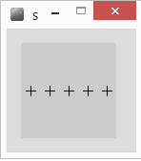
Revision
float x=10;
float y=50;
for(int i=0;i<5;i++)
{
line(x-5,y,x+5,y);
line(x,y-5,x,y+5);
x=x+20;
}
What does it do?
PseudoCode - English
For 5 repetitions
{
Draw a cross
Move right a bit
}
New
Command?

Slide 4
Code Block becomes Procedure
int x=10;
int y=50;
void cross()
{
line(x-5,y,x+5,y);
line(x,y-5,x,y+5);
}
void setup()
{
for(int i=0;i<5;i++)
{
cross();
x=x+20;
}
}
Declare & assign
variables outside
int x=10;
int y=50;
void setup()
{
for(int i=0;i<5;i++)
{
//draw cross
line(x-5,y,x+5,y);
line(x,y-5,x,y+5);
x=x+20;
}
}
Program starts here
Control passes
to procedure
When finished
Goes back to
where it was called

Slide 5
General Procedures
Procedures : block of code that performs a task,
e.g. draw a cross
Code runs when called as a command
Used to “package” a commonly used sequence of instructions (lines of code)
Code easier to design : top down design
avoid repetition
Make code more readable
Code easier to maintain
Better re-usability of code
In order to use procedures, must introduce setup()
Distinguish start code, from procedures
Notes:
Unlike event procedures you have used up to this point, general procedures must be explicitly called.
You can create procedures or functions
Functions return a single value, procedures do not
Both functions and sub procedures can have arguments
You pass information into a sub procedure or a function through its arguments
Arguments must be typed in the prototype:
Private Sub DoSomething(Arg1 as String, Arg2 as Integer)
•••
End Sub
Functions are typed in addition to their arguments:
Private Function CalcInterest(Arg1 as Currency) As Currency
CalcInterest = <expression> 'return answer this way
End Function
Place functions in same place as event sub procedures

Slide 6

Top down design?
Simple motorbike
PseudoCode – English
Draw motorbike
Draw left wheel
Draw right wheel
Draw triangle
1st stage design
2nd stage design
can convert 2nd stage to code
Notes:
Problem decomposition

Slide 7
Exercise : Motorbike
int x=20;
int y=50;
void setup()
{
ellipse(x,y,20,20);
ellipse(x+50,y,20,20);
triangle();
}
void triangle()
{
line(x,y,x+50,y);
line(x,y,x+25,y-25);
line(x+25,y-25,x+50,y);
}
2nd refactor
1st refactor
int x=20;
int y=50;
void setup()
{
motorbike();
}
void motorbike()
{
ellipse(x,y,20,20);
ellipse(x+50,y,20,20);
triangle();
}
void triangle()
{
line(x,y,x+50,y);
line(x,y,x+25,y-25);
line(x+25,y-25,x+50,y);
}
int x=20;
int y=50;
void setup()
{
//draw left wheel
ellipse(x,y,20,20);
//draw right wheel
ellipse(x+50,y,20,20);
//draw triangle
line(x,y,x+50,y);
line(x,y,x+25,y-25);
line(x+25,y-25,x+50,y);
}
Notes:
Refactor – tidying up the code. Here we can introduce a procedure to draw the triangle, next lets add a motorbike procedure

Slide 8
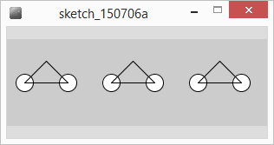
Draw 3 motorbikes
int x=20;
int y=50;
void setup()
{
size(300,100);
motorbike();
x=x+100;
motorbike();
x=x+100;
motorbike();
}
void motorbike()
{
ellipse(x,y,20,20);
ellipse(x+50,y,20,20);
triangle();
}
void triangle()
{
line(x,y,x+50,y);
line(x,y,x+25,y-25);
line(x+25,y-25,x+50,y);
}
//refactored
void setup()
{
size(300,100);
for(x=20;x<320;x=x+100)
{
motorbike();
}
}
.
Improve the code?

Slide 9
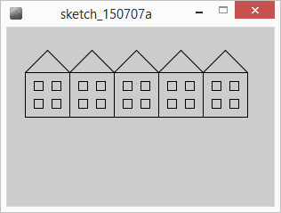
Exercise : Draw houses
Use the ideas and procedures to draw a terrace of houses
Top down design?
Pseudocode
Triangle, square

Slide 10
Summary
Problem decomposition
Top down design
Stepwise refinement
Help to design code solutions
Functions
Using, writing
Color type

